Slide 1
Managing Your Money with a Checking Account
Information taken from financeintheclassroom.org

Slide 2
Learning About Checking Accounts
Having a checking account is a good idea. Your money will be safe and you’ll have a record of what you’ve paid for. You’ll know how much you have left to use or save.
Rules to using a checking account:
Only write checks when you have enough money in your account
Write checks legibly.
Write the amount as far to the left as possible.
Always use a pen
Don’t sign a blank check.
Print the right date on checks.
Keep checks in a safe place.
Destroy voided or unused checks.
Record every transaction in the register
Keep a running balance in the register.

Slide 5
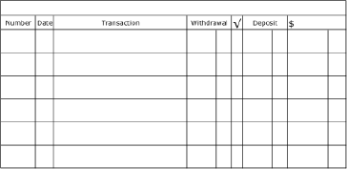
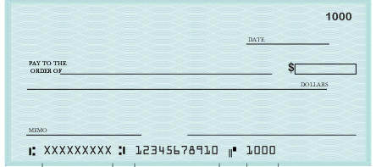
Filling Out a Check Example
I just bought groceries at Smiths for $147.15. Here is how you fill out the check
745.00
1000
10/
10
Smiths
147 15
10/10/2014
597 85
$147.15
Smiths
One hundred forty-seven and 15/100 -----------------------------
groceries
John Doe
Remember to fill out your register with every transaction you make!

Slide 6
Making a Deposit Example
I just received my paycheck for $850.50. This is how I deposit it into my account
745.00
1000
10/
10
Smiths
147 15
10/10/2014
597 85
10/
11
$147.15
Smiths
850 50
1447 35
Deposit
John Doe

